Slide 1
Lecture 19 - Feedback Systems
Notes:
Understanding systems with feedback is critical to understanding complex systems. Many complex dynamics in systems occur because of feedback that is either naturally occurring, such as acoustic feedback in an open cavity, or introduced as part of system design. Feedback is also often the technique used to stabilize and control systems. There are many undergraduate and graduate level courses that you can take in this field. These charts are an introduction to the terminology and some of the basic descriptive tools The study of feedback and control is inherently mathematical but extensive mathematics will not be used in this lecture. Instead we will attempt to provide some sense of intuition about how these types of systems work. I encourage future systems engineers to get a solid grounding in this material at least at the undergraduate level..

Slide 2
Feedback Control
Feedback is a mechanism, process or signal that is looped back to control a system within itself. Such a loop is called a feedback loop. In systems containing an input and output, feeding back part of the output so as to increase the input is positive feedback; feeding back part of the output in such a way as to partially oppose the input is negative feedback.
Negative feedback occurs when the output of a system acts to oppose changes to the input of the system; with the result that the changes are attenuated. If the overall feedback of the system is negative, then the system will tend to be stable
Negative feedback was first implemented in the 16th Century with the invention of the centrifugal governor. Its operation is most easily seen in its use by James Watt to control the speed of his steam engine.
  Two heavy balls on an upright frame rotate at the same speed as the engine.
    As their speed increases they move outwards due to the centrifugal force. This causes them to lift a mechanism which closes the steam inlet valve and the engine slows.
    When the speed of the engine falls too far, the balls will move in the opposite direction and open the steam valve.
Courtesy Wikipedia
Notes:
Negative feedback, or feeding back the difference between a desired state and an actual state is the most common type of stabilizing and control mechanism.
At the intuitive level – it makes sense, if you have an error – or difference between the desired and actual state, then the amount of restoring control should be opposite to the direction of error and should grow proportionately with the error. The bigger the error, the bigger the restoring control is required.

Slide 3
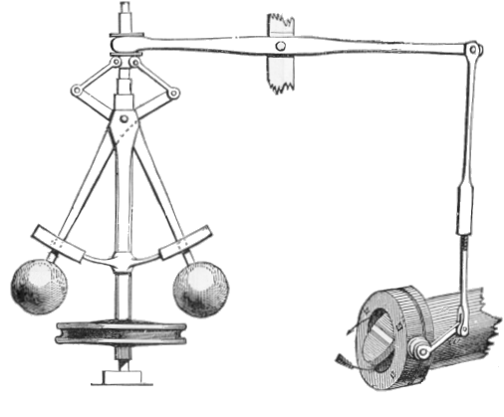
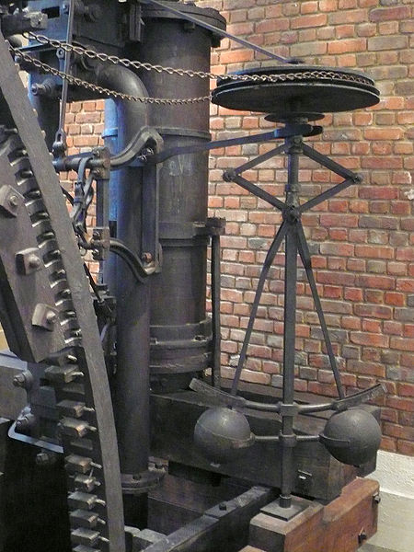
Watt Governor – The Mechanical Negative Feedback Control System that led to the industrial revolution
Notes:
The Watt Governor, used to control steam powered devices, was crucial to the industrial revolution. Steam provided the power for revolution, but Watts governor provided the control necessary to do anything with that power.

Slide 4
How does it work ?
Power is supplied to the governor from the engine's output shaft by (in this instance) a belt or chain (not shown) connected to the lower belt wheel.
The governor is connected to a throttle valve that regulates the flow of working fluid (steam) supplying the prime mover (prime mover not shown).
As the speed of the prime mover increases, the central spindle of the governor rotates at a faster rate and the kinetic energy of the balls increases.
This allows the two masses on lever arms to move outwards and upwards against gravity.
If the motion goes far enough, this motion causes the lever arms to pull down on a thrust bearing, which moves a beam linkage, which reduces the aperture of a throttle valve.
The rate of working-fluid entering the cylinder is thus reduced and the speed of the prime mover is controlled, preventing over-speeding.
Courtesy of wikipedia

Slide 5
Negative Feedback Diagram
Summing
Junction
Error = setpoint-feedback
Control signal
System Output
+
setpoint
System
Dynamics
(Plant)
Forward Loop Gain
G
-
feedback
Feedback Loop Gain
H
Notes:
This is the diagrammatic way we describe a negative feedback control loop.
On the left is the setpoint or the desired state of the system whether it is a speed or position.
The error signal is generated by subtracting the current state of the system (the feedback) from the setpoint.
The error, or deviation of the system from the setpoint, is multiplied by the forward loop gain. The higher the forward loop gain, the faster the system will respond, because the bigger gain causes a larger response for the same size error.
You can think of the forward loop gain like a driver trying to maintain a constant speed on the road. If the driver applies only a slight brake or gas when there is an error, then the system will slowly return to the desired speed. If the driver has a heavy foot, and applies a ot of brake or gas when there is an error, then the system has a higher gain and it more rapidly returns to the desired state.
The problem with high gain, as we will see, is the possibility of overshoot and actually causing instability in the system.
The system dynamics are the actual rsponse of the system to the control. The feedback gain either increases or decreases the system value before it is added to the setpoint. Feedback gain can be used to stabilize a system with a high forward loop gain.

Slide 6
Can Negative Feedback Systems be Unstable ?
Yes !!!
If the lag between applying a control and observing the plant response is large enough to reverse the sign of the feedback signal, a negative feedback system can be unstable
The higher the forward loop gain or the longer the system delay, the more likely this is to happen
Notes:
Lag is also very important to understand in negative feedback systems. If your feedback lags behind the system significantly, there is the possibility that a negative feedback system can actually destabilize a system.
Lag can occur as part of the control system design or can be inherently part of a systems dynamics. For example, if you are warming a block of metal, the mass has thermal lag because the entire system does not receive all of the heat uniformly and simultaneously. So for example, if you are heating a cube of metal and the feedback sensor is in the center of a block of metal, then by the time the interior of the block reaches the desired temperature, the outer parts of the block are hotter than the interior.
So even if you turn off the heat when the interior of the block reaches the desired temperature, then the interior of the block will continue to warm up because the mass on the outer part of the block will continue to transfer heat because it is hotter than the inside of the block,
The only way to deal with lag, is to “lead: the system. In the case of a block of metal, when the block reached a temperature a little below the desired, you would need to back the heating down so the temperature settled into the proper value.

Slide 7
Positive Feedback
Positive feedback is inherently de-stabilizing
Positive feedback, sometimes referred to as "cumulative causation", refers to situations where some effect causes more of itself. Under strong positive feedback, most systems quickly move to a limit state, where the limit is provided by external factors, or into some other new stable state where the positive feedback is somehow negated. Positive feedback can also lead to oscillation.
Courtesy Wikipedia

Slide 8
Positive Feedback Diagram
Summing
Junction
Error = setpoint-+eedback
Control signal
System Output
+
setpoint
System
Dynamics
(Plant)
Forward Loop Gain
G
+
feedback
Feedback Loop Gain
H
Notes:
We represent positive impact by a summing junction where the current state of the system (feedback) is added to the setpoint and then multiplied by the gain.
We observe this often with audio systems in auditoriums. If the gain on a speaker system is too high and someone speaks into a microphone, then the amplified signal being transmitted by the speakers can be picked up by the microphone and then it is amplified further. This continues ona nd on with the signal getting louder until someone in the audience screams “Feedback”. And that’s exactly what it is, positive feedback.

Slide 9
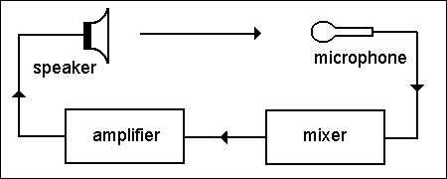
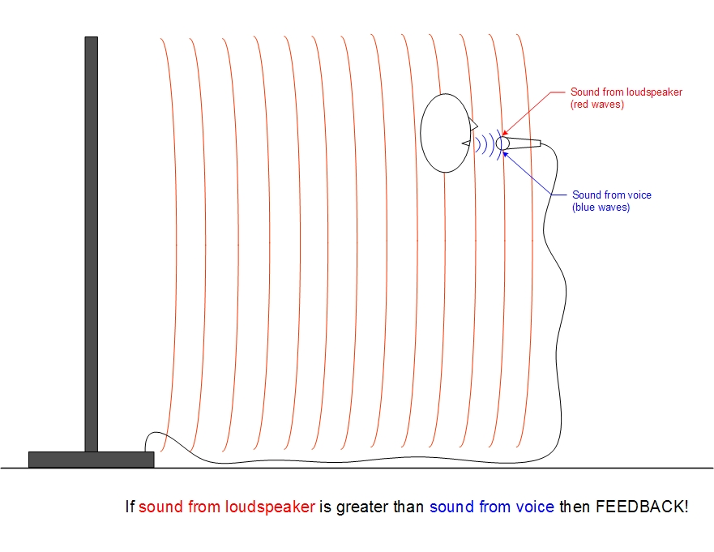
Audio Positive Feedback
Graphic
courtesy
of wikipedia

Slide 10
System Block Diagrams
Systems with feedback control systems are often represented as block diagrams
These have unique nomenclature
There are some simple ways to reduce these diagrams

Slide 11
Basic Functions
Input
G
Output
Output=(G)(Input)
+
+
Output
Input1
Output
Input1
-
+
Input2
Input2
Output=Input1-Input2
Output = Input1+Input2

Slide 12
Input
+
Output
-
Basic Feedback Loop

Slide 13
Input
+
Forward
Gain
Output
-
Feedback
Gain
Input
+
Output
G
-
H

Slide 14
Product Reduction
G1
G2
G1G2

Slide 15
Reduction – Combining Gain before a junction
G1
G2
+/-
Can be replaced by
G1+/-G2

Slide 16
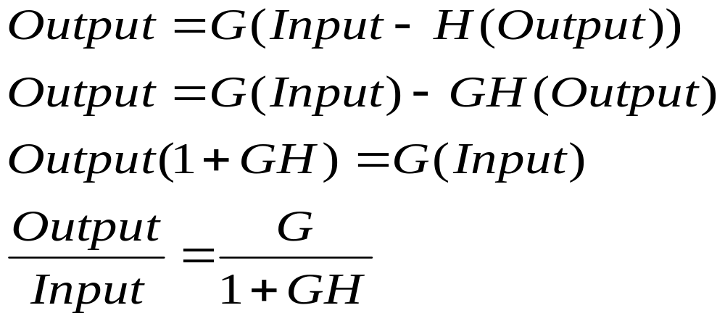
Negative Feedback Loop
Input
+
Output
G
-
H
If G sufficiently large, Output follows Input

Slide 17
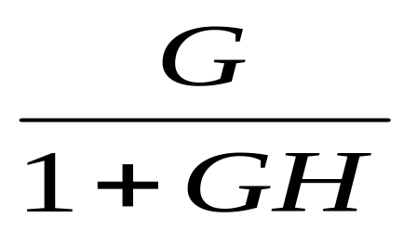
Reduction
Input
+
Output
G
-
H
Can be replaced by

Slide 18
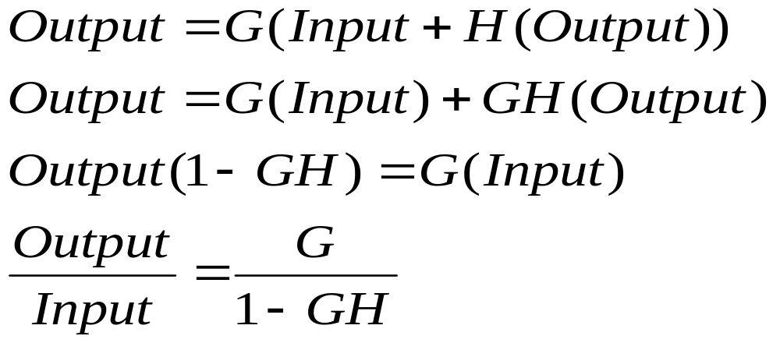
Positive Feedback Loop
Input
+
Output
G
+
H
If G sufficiently large, output = -input which results in oscillation

Slide 19
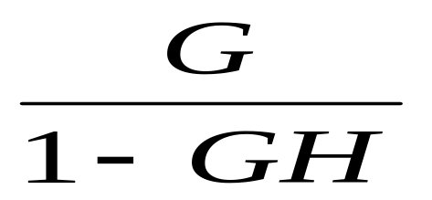
Reduction
Input
+
Output
G
+
H
Can be replaced by

Slide 20
Summing Junction Combination
W
Z
Y
X
X
W
Z
Y

Slide 21
Reduction – Moving gain outside the loop
G
Can be replaced by
G
G

Slide 22
Reduction - Moving Gain Outside the Summing junction
X
G
Y
Can be replaced by
G
X
G
Y

Slide 23
Reduction – Moving Gain inside the loop
G
Can be replaced by
G
1/G

Slide 24
Reduction – Gain on one input moved inside a junction
X
G
Z
Y
Can be replaced by
X
G
Z
1/G
Y

Slide 25
Proportional Integral Derivative Controller
A proportional–integral–derivative controller (PID controller) is a generic control loop feedback mechanism (controller widely used in industrial control systems –
A PID is the most commonly used feedback controller.
A PID controller calculates an "error" value as the difference between a measured process variable and a desired setpoint.
The controller attempts to minimize the error by adjusting the process control inputs. In the absence of knowledge of the underlying process,
PID controllers are the best controllers.
However, for best performance, the PID parameters used in the calculation must be tuned according to the nature of the system – while the design is generic, the parameters depend on the specific system.
The PID controller calculation (algorithm) involves three separate parameters, and is accordingly sometimes called three-term control: the proportional, the integral and derivative values, denoted P, I, and D.
The proportional value determines the reaction to the current error, the integral value determines the reaction based on the sum of recent errors, and the derivative value determines the reaction based on the rate at which the error has been changing.
The weighted sum of these three actions is used to adjust the process via a control element such as the position of a control valve or the power supply of a heating element.
Heuristically, these values can be interpreted in terms of time: P depends on the present error, I on the accumulation of past errors, and D is a prediction of future errors, based on current rate of change.
Courtesy wikipedia

Slide 26
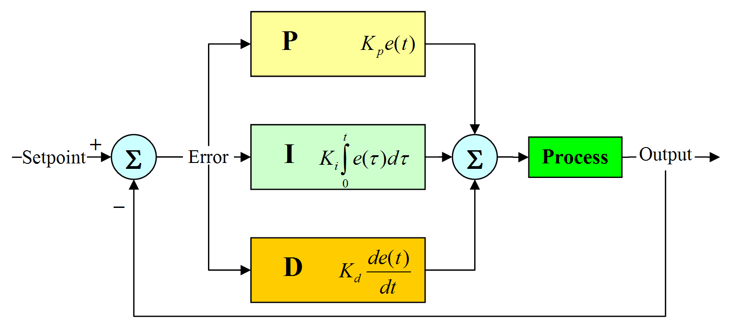
Proportional – Error times gain
Integral – gain times the integral of the past errors. Integral takes care of accumulated error
Derivative – Gain times the rate that the error is increasing or decreasing
PID diagram – courtesy of Wikipedia

